Slide 1
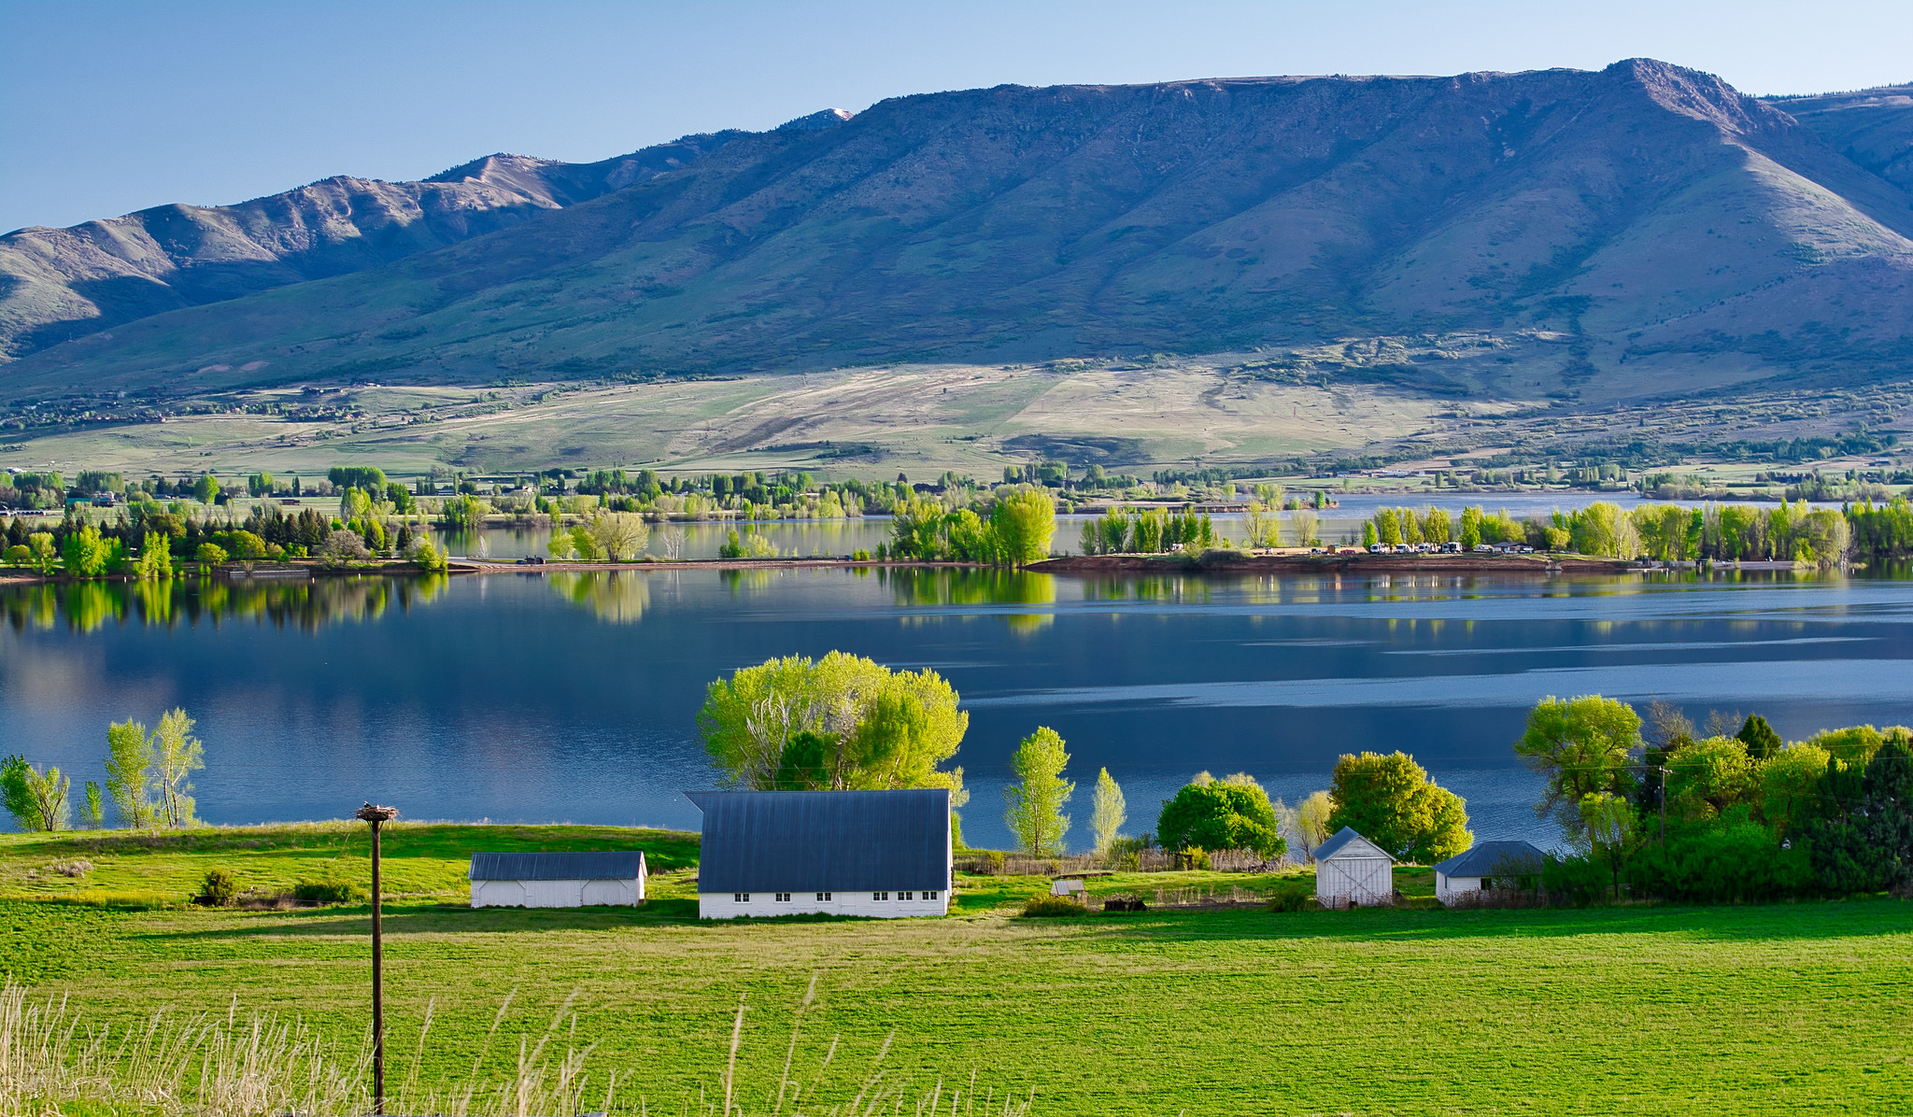

Town Hall
&
Open House
March 26, 2025
Huntsville Town Hall
Hosted by
Incorporation Transition Team
&
Ogden Valley Startup, Inc.
Thanks to Huntsville Town for Opening Up
Their New Town Hall to Us

Slide 2


Tonight’s Agenda
Why Prepare Now?
From Sponsors to Startup
What’s the Work?
Who Does It?
Volunteer Team Breakouts

Slide 3

Officials Will Have Little Time to Prepare
Why Prepare Now?
June
July
August
Sept
Oct
Nov
Dec
Jan
Candidate
Declaration
Primary
Election &
Canvass (official confirmation) (Nov. 18)
Take Office
(Jan. 5)
Officials Will Have NO authority until November 18
Even then, it’s limited
WE MUST BE READY BEFORE THEN!
21 Business Days

Slide 4
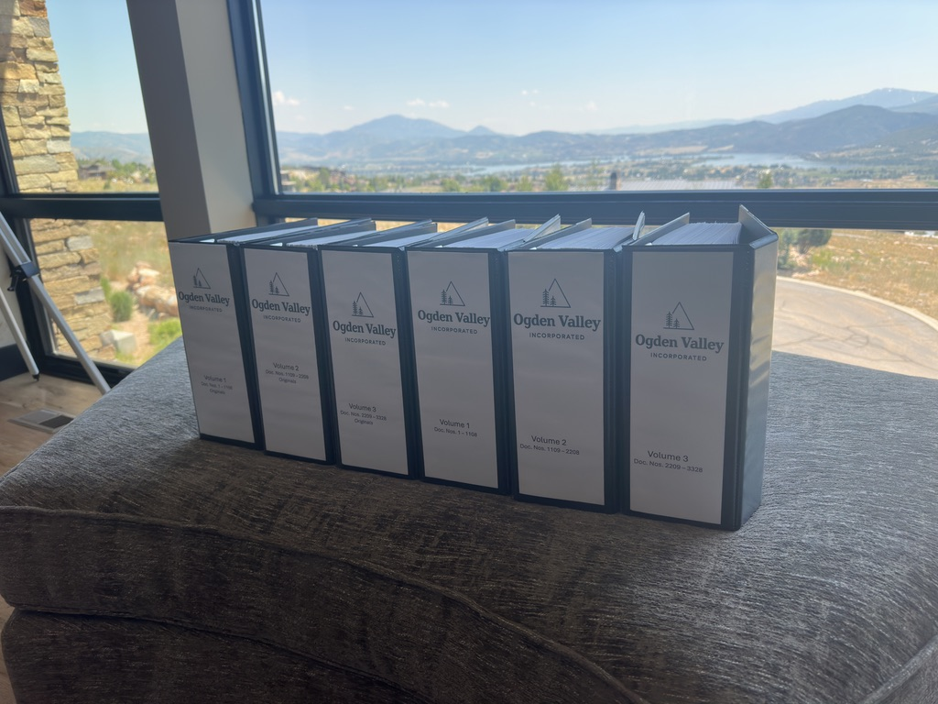


From Sponsors to Transition Team to Startup
Sponsors
6 Sponsors
Mission: Get on the Ballot
”Sponsor Duties” Completed on January 16, 2025
Transition Team
2 Sponsors + 5 volunteers + WFRC
Mission: Research & Prepare for Startup Work
  Nick Dahlkamp, Brandi Hammon
  Wayne Pyle, Angela Dean, Janet Wampler, Anne Ladd, Kay Hoogland
  Wasatch Front Regional Counsel – Madison Aviles
Ogden Valley Startup, Inc.
Volunteers (100+) INCLUDING YOU!
Mission: Do the Startup Work

Slide 5


What Is Ogden Valley Startup?
From Sponsors to Campaign to Startup
Two separate entities:
  Sponsors
  Campaign Committee (Friends of Ogden Valley)
Compliance with state laws on registration, reporting, and wind-up after consultation with Lieutenant Governor’s Office
Friends of Ogden Valley Donors of $500+
  Offered option of refund or rollover to Ogden Valley Startup, Inc.
  Rollover ~ $8000

Slide 6
What Is the Work?
City Startup Manual
a step-by-step guide on how to startup the city
TABLE OF CONTENTS
Candidate Startup Training
Essential Tasks Post Election & Canvass
  November 18 - December: Modest Statutory Authority
Essential Tasks January 5, 2026: First Week
  Secure Revenue
  Contract Ratification & Adoption
  Codes, Policies, Procedures
  Legal Filings & Records
First Six Months
  Normalize Operations
Appendix
  Draft Documents, Resources, Calendar, Other Tools

Slide 7
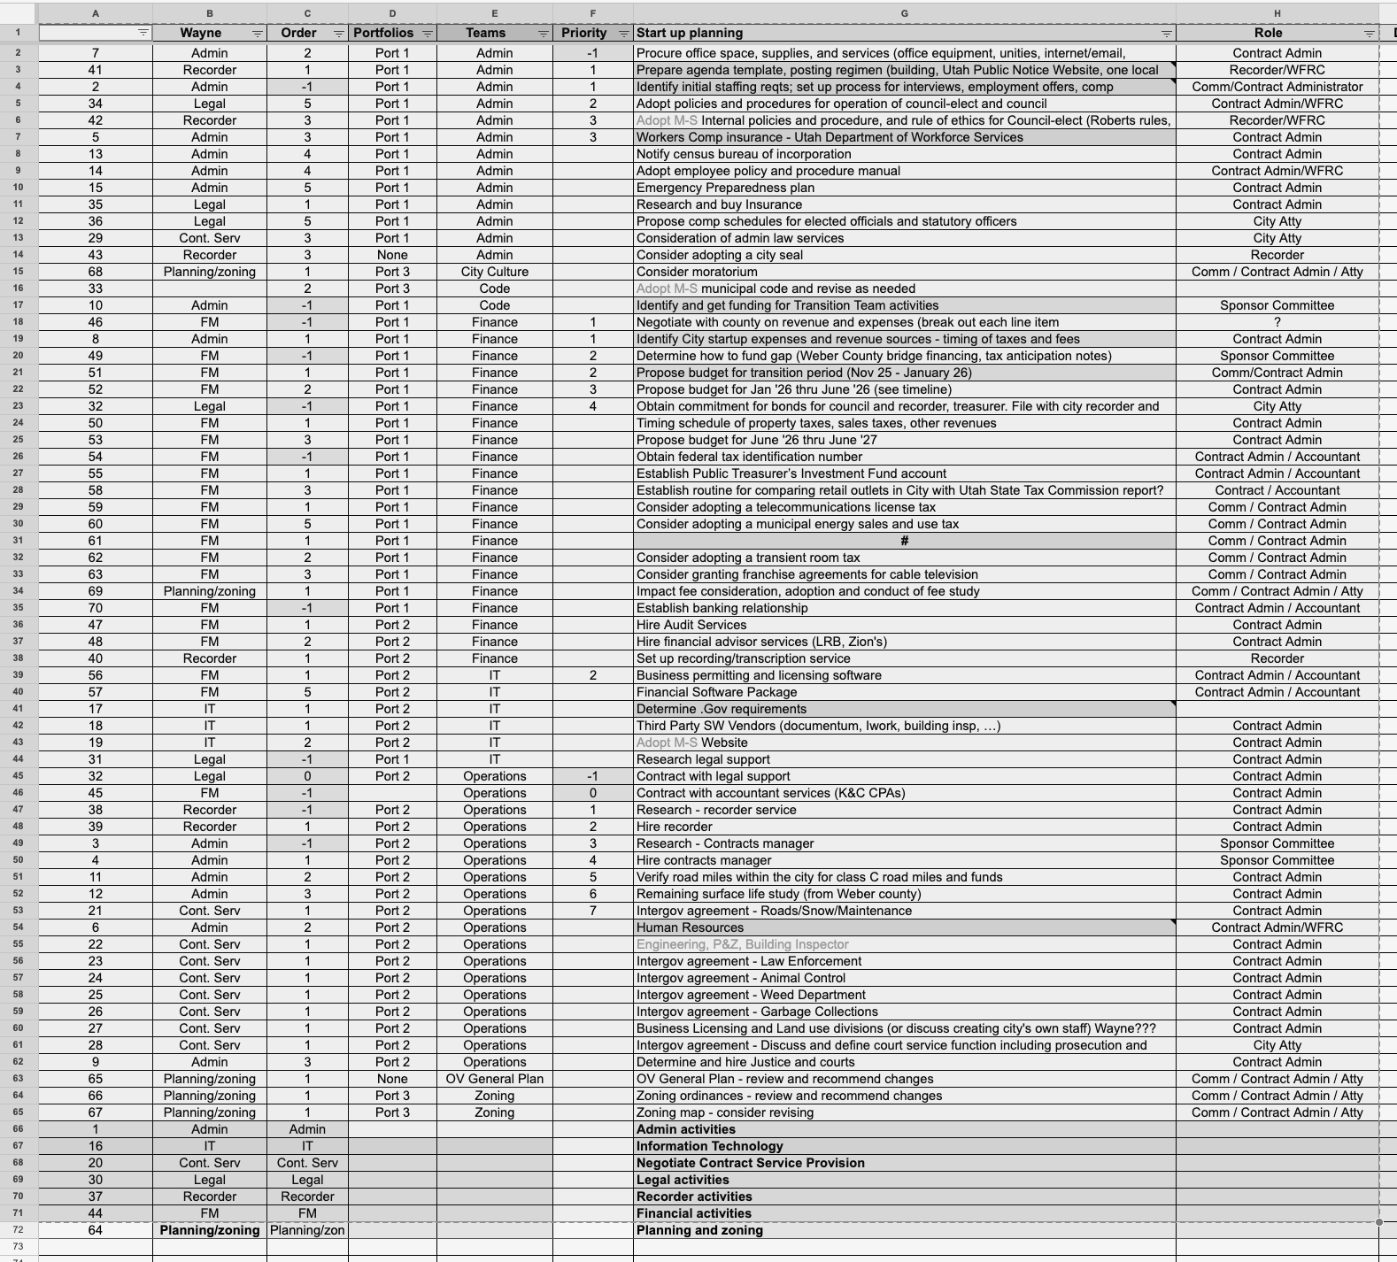

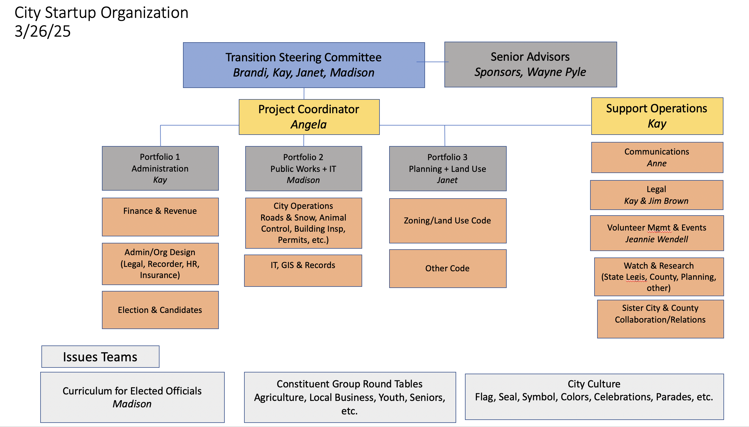
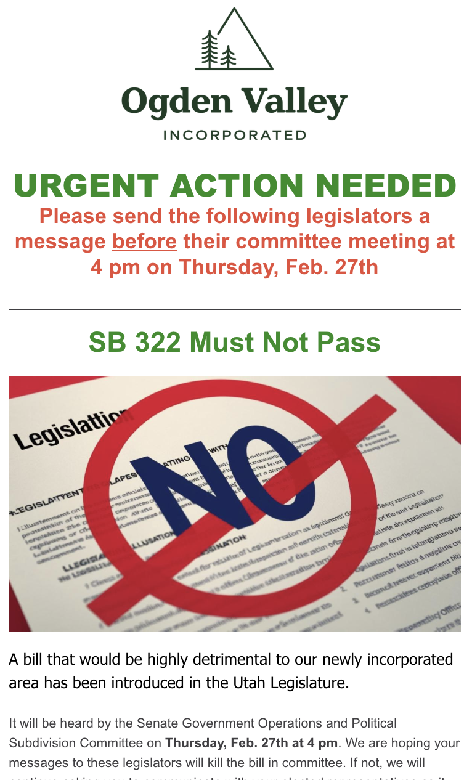
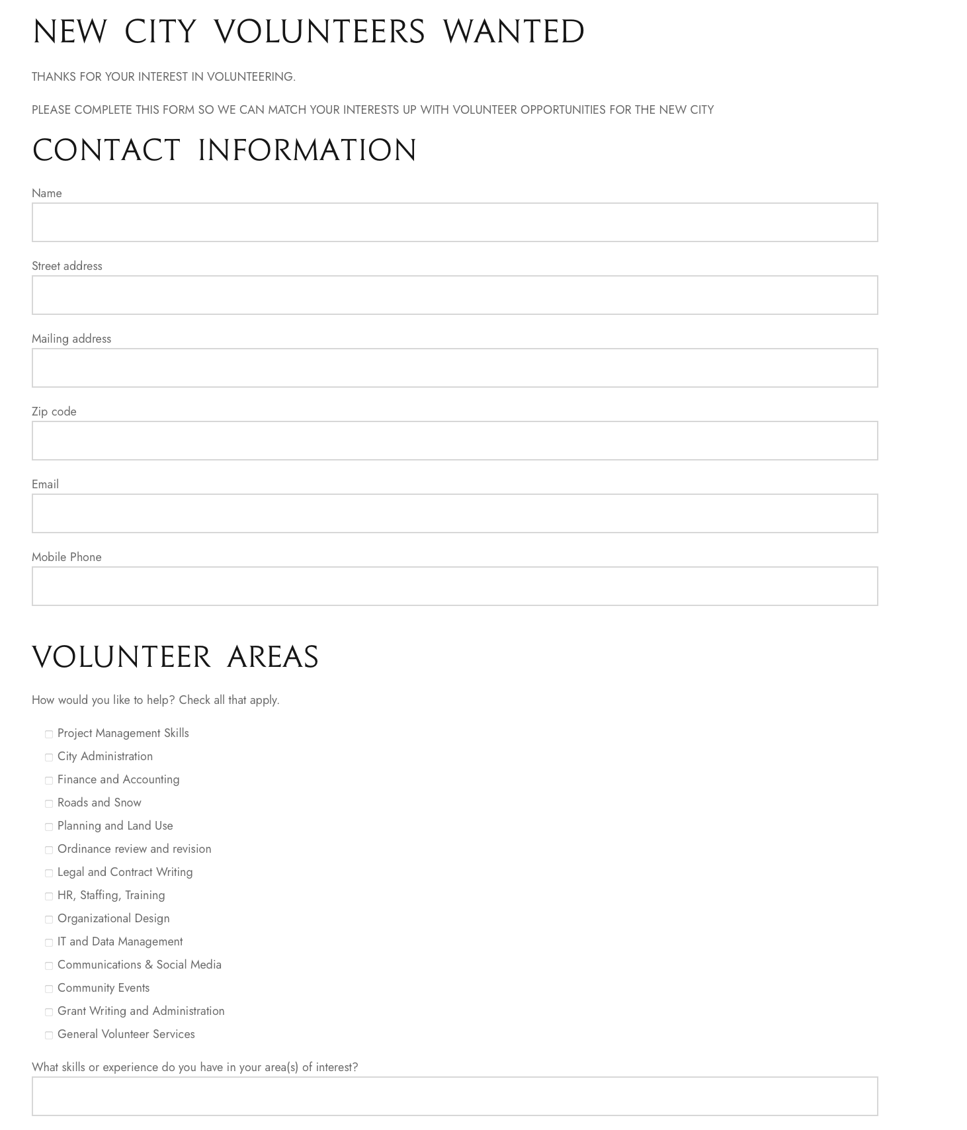





What Is the Work?
Already Done
Master Task List
Organization Design
Other Cities’ Experiences
Volunteer Data Base
Communications
Legislative Watch
Legal Research
Relationships/Network/Outreach

Slide 8

Who Does the Work?
DIY
(Valley Volunteers)
Local Talent & Knowledge
Availability Varies
Price is Right, but Still Has Costs
Turnkey
(Marriott-Slaterville?)
Proven Expertise
Prepare to Go January 2026
Cost – Who Pays?
Sweet Spot Option
Interlocal Agreement (under discussion)
  Potential County Funding
  Division of Tasks (Volunteers vs. Outside)
  Volunteer Review of Turnkey Work

Slide 9
What Can You Do Now?
Volunteers
Volunteer matchup
Participate in teams
Practice “leadership & followership”
Share information
Practice transparency
Provide feedback & ideas
BE A CANDIDATE!
Candidates
Join transition work teams and LEARN!
Review incorporation website https://www.ogdenvalleyinc.org
Consult web resources
  League of Cities & Towns
  Sites on How to Campaign
Talk with friends & neighbors

Slide 10
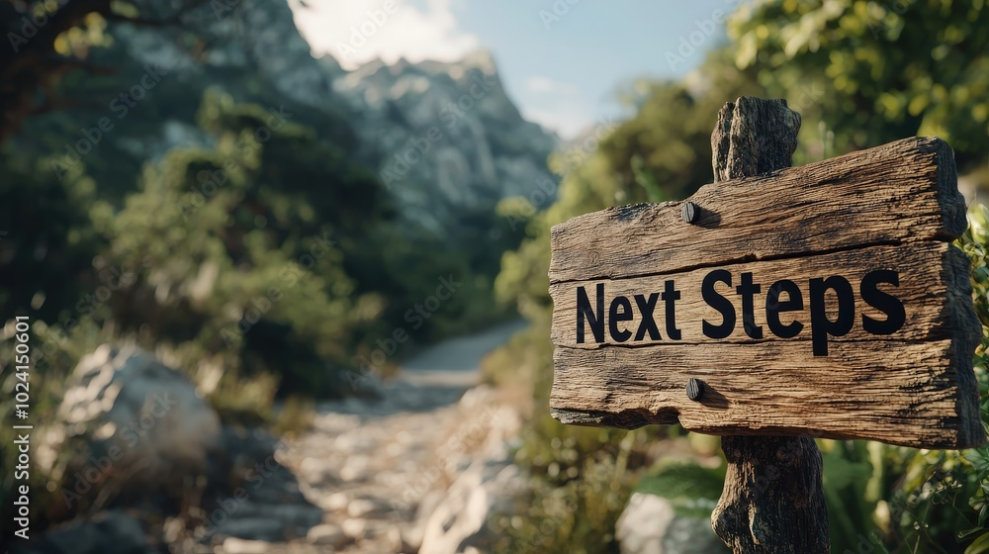
What Is the Work?
Next Steps*
Divide & Prioritize Tasks (Volunteers vs. Outside)
Distribute the Work
Set Deliverables & Due Dates
Regular Progress Reviews
Documentation
*Other work continues (communications, research, legal, etc.)

Slide 11

Election Timeline
Candidate Declaration Period
June 2-6 (10 AM – 5 PM@ Ogden Valley Library)
Pre-Election Trainings
Candidate Training (June 19, 6:00 PM - 7:30 PM )
Primary Election
August 12: Primary Election Day
August 26: Canvass (Confirm Results)
General Election
October 24: Voter registration deadline
November 4: General Election Day
November 18: Canvass (Confirm Results)
Courtesy of Weber County Clerk’s Office, (all dates are subject to change, based on possible legislative changes)
Detailed Copies Available at Meeting Table
03/26/25

Slide 12
Volunteer Organization
Transition Steering Committee
Senior Advisors
Sponsors
Project Coordinator
Support Operations
Critical Path Teams
Committee 1
Administration
Committee 2
Public Works + IT
Committee 3
Planning + Land Use
Communications
Legal
Finance & Revenue
City Operations
Roads & Snow, Animal Control, Building Insp, Permits, etc.)
Zoning/Land Use Code
Volunteer Mgmt & Events
Other Code
Admin/Org Design
(Legal, Recorder, HR, Insurance)
IT, GIS & Records
Watch & Research
(State Legis, County, Planning, other)
Election & Candidates
(Critical Dates, Trainings, Resources)
Sister City & County Collaboration/Relations
Issues Teams
Curriculum for Elected Officials
Wasatch Front Regional Council
Constituent Group Round Tables
Agriculture, Local Business, Youth, Seniors, etc.
City Culture
Flag, Seal, Symbol, Colors, Celebrations, Parades, etc.

Slide 13
Thank You!

